Slide 1
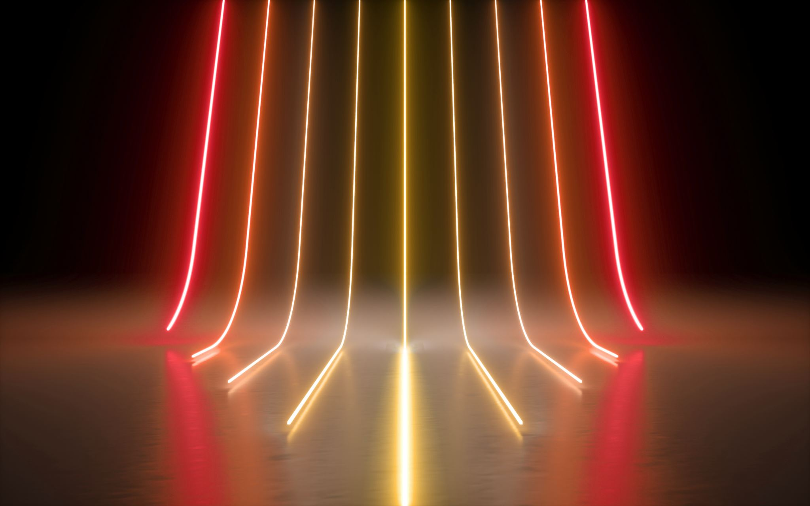


EMBRYOLOGY
EMBRYOLOGY
PART 1: INTRODUCTION
PART 2: RESPIRATORY
PART 3: CARDIOLOGY
PART 1: INTRODUCTION
PART 2: RESPIRATORY
PART 3: CARDIOLOGY

Slide 2
PART 1: INTRODUCTION
Emayanthi (Emi)

Slide 3
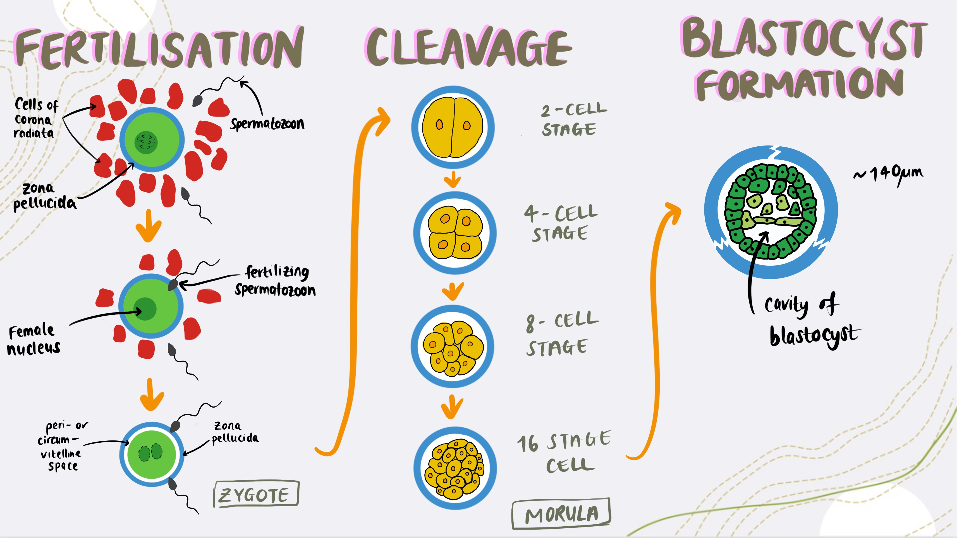
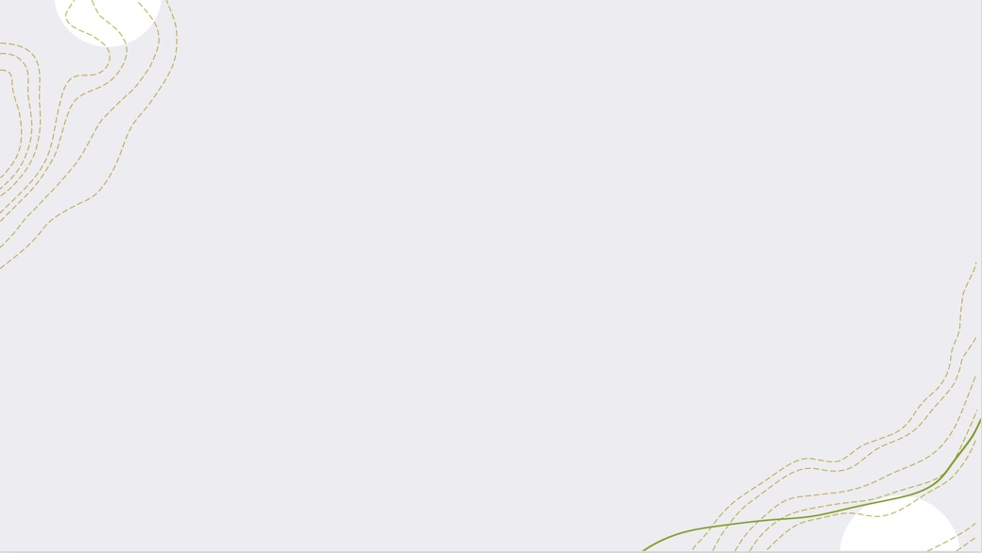
Notes:
Fertilisation happens in the ampulla of the uterine tube.
Fertilisation
Secondary oocyte is stuck in metaphase II and is waiting for the sperm cell is come (they travel due to muscular contraction of uterus and uterine tube) but in order for it to touch it has to undergo a process called capacitation (→ sperms head needs to clean of cholesterol molecule etc..) and has to attach to ZP₃ receptors (specific type of protein) on oocyte membrane.
3 phased of fertilisation:
Phase 1: Penetration of Corona Radiata
capacitated sperm passes free through
Phase 2: Penetration of Zona Pellucida
Once sperm comes in contact with ZP3 receptors it activates the head of the sperm head cell, and it fuses with the oocyte membrane (Acrosomal enzymes help disperse corona radiata and aid penetration of zona pellucida).
This contact also releases lysosomal enzymes from cortical granules lining the plasma of oocyte. (Enzymes released by cortical granules digest sperm receptor proteins ZP2 and ZP3 so that they can no longer bind to sperm.)
Phase 3: Fusion of the oocyte and sperm cell membrane → the egg responds in 3 ways when spermatozoon enters:
Cortical and Zona reaction → oocyte membrane becomes impenetrable due to release of lysosomal enzymes; Permeability of zona pellucida altered to prevent further penetration - 'zona reaction’.
Resumption of the second meiotic phase → chromosomes of definitive oocyte arrange themselves as the female pronucleus (vesicular nucleus)
Metabolic activation of the egg → most likely carried by the spermatozoon.
Sperm releases its nucleus into the cytoplasm (of oocyte). Goes from haploid to diploid cell (zygote).
Ovum shrinks → perivitelline space. Note the gametes contribute DNA equally but the cytoplasmic contribution is grossly unequal
Zygote undergoes a lot of proliferation (Show a quick overview of cell cycle; G1, S, G2, M) and continues replicating and replicating → 2, 4, 8 cells… this is called cleavage.
Cleavage
Zona pellucida is present in fertilisation, zygote and 2-cell stage. Then divide again, so 4 cell stage. Then divide again to become 8 cell stage then 16 cell stage. In the 16-cell stage, you have a spherical ball like shape formed by these cells, however it is hollow inside.
Anything after the 16-cell stage and up till blastocyst is called the morula. The cells in the morula are called blastomeres.
Whilst this cleavage process is happening, they are moving towards the uterine cavity. It has certain types of proteins that allow it to implant itself on the endometrium.
Now compaction occurs which segregates the inner cells (gives rise to embryo proper) from outer cells (give rise to trophoblast which then gives to placenta). There are cells tightly arranged on all around the edge and some cells that group together on edge together. → this is called blastocyst.
Blastocyst Formation
Going from morula to blastocyst. About the time morula enters the uterine cavity. Fluid enters the intercellular space of the inner cell mass, and forms a single cavity called blastocele.
Now outer cell mass becomes the trophoblast (as it is a little more differentiated than before), and inner cell mass becomes the embryoblast and will be at one pole. Zona pellucida has now disappeared, allowing implantation to begin.
Trophoblast will then become part of the chorion and also part of the placenta.
Trophoblast differentiates to become the cytotrophoblast and Synctiotrophoblast.
Embryoblast will eventually start developing into bilaminar disc (epiblast and hypoblast).

Slide 4
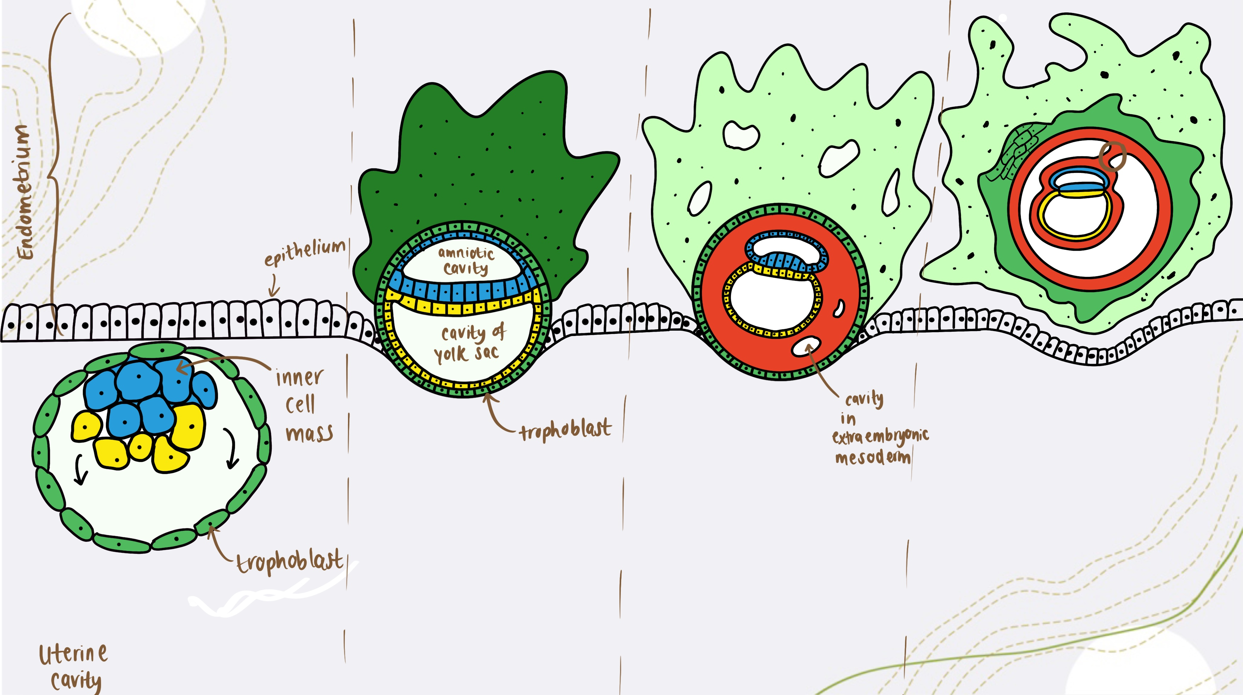
Implantation
Notes:
Once the embryo implants via the integrins and selectins to the uterine wall (nearer the fundus than the cervix).
Trophoblast divides intro Synctiotrophoblast and cytotrophoblast. Outer cell layer is cytotrophoblast (cell margins) with nucleus inside the cell. Other cells proliferate and cell membranes disintegrate, and this happens outside the zona pellucida. When cell membrane disintegrates it forms a fluid, a cytoplasm, which consists the nuclei of all these cells. All of the cytoplasm of the cells starts to fuse together forming a syncytium → that is called our Synctiotrophoblast. Not well-defined cell margins. Eventually what will happen is that cells within the synchiotrophoblast will start forming a villi/ finger projection-like structure that extends through this.
This is important as eventually the Synctiotrophoblast will continue to release certain types of hydrolytic enzymes that will work its way through the actual uterine lining, which contains maternal blood vessels, until it reaches it and become confluent with this. Thus, the embryo can actually start receiving oxygen, nutrients, hormones and things needed to survive.
Around day 24, to prevent the shedding of the endometrial lining, synchiotrophoblast starts producing a specific type of hormone (β-HCG), it has the ovaries to continue producing progesterone and so progesterone levels remain elevated. Therefore, prevents the spasming of those blood vessels in the endometrial, and prevents shedding. Therefore, allows proper nutrition like glycogen, and all those different types of lipids produced to nourish the baby- to ensure theirs proper implantation

Slide 5
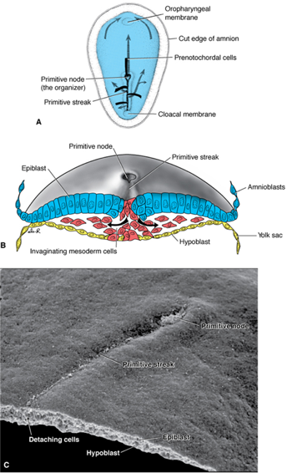
Gastrulation
Notes:
Signalling process causes the epiblast cells to cause a thick area around them, making a primitive streak thickening of tissue) and the circler end closer to the cephalic end will be called a primitive node → this is all on the surface of the epiblast. Then some of the cells in the primitive streak and primitive node start dying at the centre and start making a cavity. Cells at the end of this primitive streak start secreting some chemicals called fibroblast growth factors-8 (FGF-8) and others too. FGF-8 is s secreted laterally and these will bind to epiblast cells and triggers an intracellular process which triggers the formation o f a protein called SNAIL-1. This inhibits the formation of E-cadherins (this protein causes cells to be linked up together). Thus, cells can migrate now, and this is called epithelial migration.
Now the cells will start moving towards the primitive streak. This inward movement is known as invagination. The space in the primitive streak is now called the primitive groove, the space in the primate node is now called primitive pit. Those epiblast cells now move through the primitive groove, and move down where the hypoblast is, and replaced with epiblast creating the embryonic endoderm. Other cells lie between the newly created endoderm and the epiblast creating the mesoderm. And the pre-existing epiblast layer becomes the ectoderm.
Process of gastrulation produces the 3 germ layers from epiblast.

Slide 6
SPERM + EGG
ZYGOTE
MORULA
BLASTOCYST
TROPHOBLAST
EMBRYOBLAST
SYNCTIO-
CYTO-
HYPOBLAST
EPIBLAST

Slide 7
EPIBLAST
PRIMITIVE STREAK
ENDODERM
MESODERM
ECTODERM
NEURAL
PARAXIAL
LATERAL
INTERMEDIATE
SOMITES
NEURAL
TUBE
(CNS)
NEURAL
CREST
(PNS)
Splanchnic
Somatic
Sclerotome
Myotome
Dermatome
NEPHROTOME
(urogenital)

Slide 8
Summary
Week 2: Bilaminar Disc
  2 Layers
  2 Cavities (amniotic and yolk sac)
  2 Trophoblast derivatives (cyto- and synchtio-)
Week 3: Trilaminar Disc
  Ectoderm
  Mesoderm
  Endoderm
Week 4: Four Limbs

Slide 9
Thank you!
Resources Used:
LMS Lecture Slides
YouTube: NinjaNerd
Langman’s Medical Embryology
Hope this session was useful!
If you have anymore questions or queries, don’t hesitate to contact me: mzyee5@nottingham.ac.uk

Slide 10
PART 2: RESPIRATORY
Naima

Slide 11
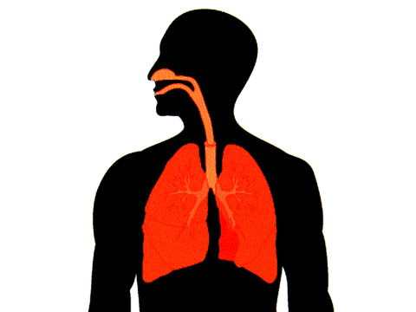
Basic Lung anatomy
Nasal cavity
Pharynx
Larynx
Trachea
Pharynx vs Larynx?
Left lung
Pharynx: Throat
Larynx: Voice box
Right lung
Diaphragm

Slide 12
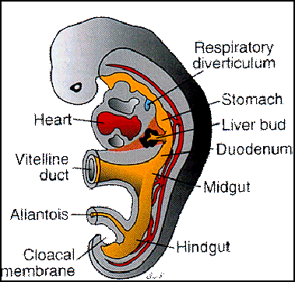
Week 4
Lung bud (aka respiratory diverticulum) forms
Question:
With this information, are the lungs derived from the endoderm, mesoderm or ectoderm?

Slide 13
Week 4 continued
Oesophagotracheal ridges fuse to form the oesophagotracheal septum
Oesophagotracheal
ridge
Oesophagus
Foregut
Laryngotracheal
tube
Laryngotracheal
tube
Respiratory
diverticulum
Lung bud

Slide 14
4 stages of lung maturation
Pseudoglandular (wk 5-16)
2) Canalicular (wk 16-26)
3) Saccular (wk 26-birth)
4) Alveolar (after birth→ childhood & adolescence)

Slide 15
Pseudoglandular phase (5-16 weeks)
Lung bud (aka respiratory diverticulum) forms
Question:
With this information, are the lungs derived from the endoderm, mesoderm or ectoderm?
Trachea, bronchi → terminal bronchioles. No respiratory bronchioles or alveoli
Question:
Why can’t babies born at this stage not survive?

Slide 16
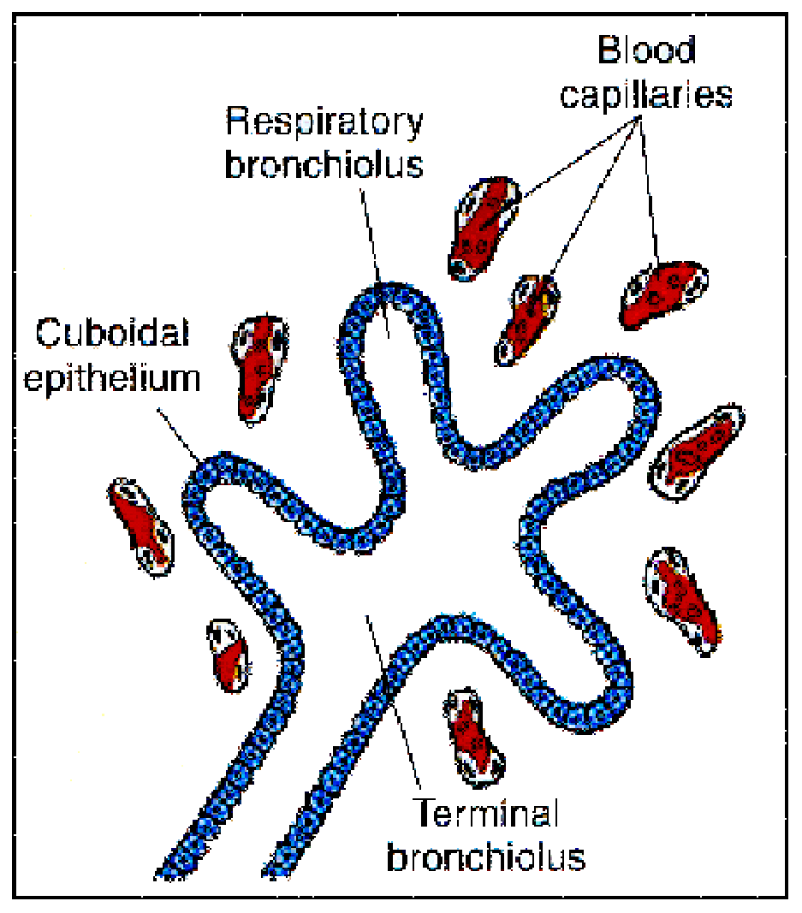
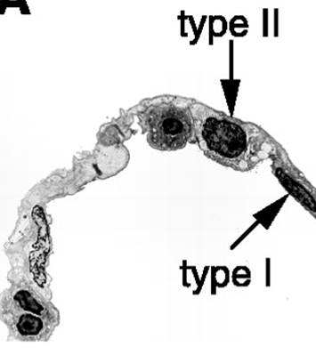
Canalicular phase (16-26 weeks)
Divides into respiratory bronchioles & further divides into alveolar ducts
Babies born at this stage can survive
Type II (2) Pneumocytes form & produce surfactant→ lowers surface tension & keeps alveoli open so it doesn’t collapse

Slide 17
Saccular phase (week 26→ birth)
Terminal sacs & early structures of the alveoli form at this stage
Blood supply becomes more rich as capillaries increase in number

Slide 18
Alveolar phase (After birth)
Amniotic fluid is removed to make room for air
Rest of mature alveoli develop from birth to early adolescence

Slide 19
Thank you
References:
Wikipedia
Slides from moodle
Email: mzyno3@nottingham.ac.uk

Slide 20
PART 3: CARDIOLOGY
Sneha

Slide 21
Stages of Heart Development
_{Linear heart tube formation}
⬇
_{Formation of the cardiac loop}
⬇
_{Heart septation}
⬇
_{Cavitation of ventricle}
Formation of valves and great vessels
⬇
_{4-chambered heart}

Slide 22
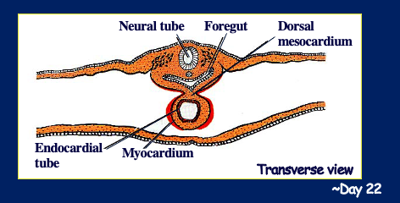
Linear Heart Tube Established
Notes:
3 main layers:
Ectoderm- blue
Mesoderm- orange- 3 parts of mesoderm- paraxial, intermediate and lateral plate
Lateral divided into- somatic and splanchnic
Endoderm- yellow
Heart derives from mesoderm
Day 16- Primary and secondary heart field which originate from the primitive blast and move to the splanchnic mesoderm
Primary heat field above the neural crest
Secondary heart field is below the neural crest
Forms a horseshoe shaped structure
Linear Heart Tube comes from the primary and Secondary heat fields
Fold inwards and join together to form the endocardial tubes (2) and then fuse together to form one endocardial tube

Slide 23
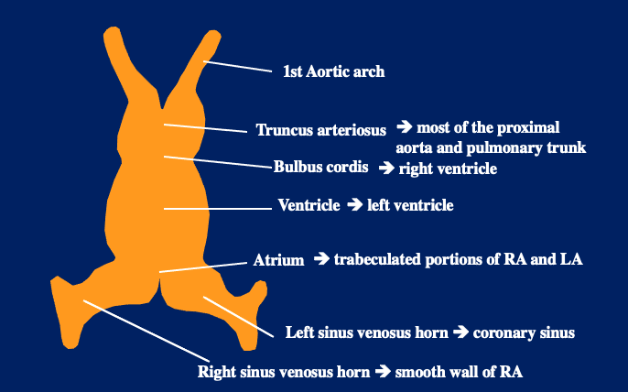
Ventral view of Endocardial Tube
Notes:
Heart tube is endocardial tube
Bulbous cordis has 3 parts to it
1.) Proximal 1/3- no name- gives rise to the right ventricle
2.) Middle 1/3- known as the cone cordis- forms the outflow tract
3.) Distal 1/3- known as the truncus arteriosus- ascending aspect of aorta and pulmonary trunk
Primitive Ventricle- mainly forms the left ventricle
Bulbo ventricular sulcus- between bulbus cordis and primitive ventricle- forms intraventricular septum
Junction primitive ventricle and primitive atria- called atrio-ventricular canal- AV Canal
Primitive atria- gives rise to right and left atria
Sinuous venous- you have left and right trunk
right forms superior and inferior vena cava- inflow tract
Left forms part of the coronary sinus- part of the coronary veins which takes blood away from the heart

Slide 24
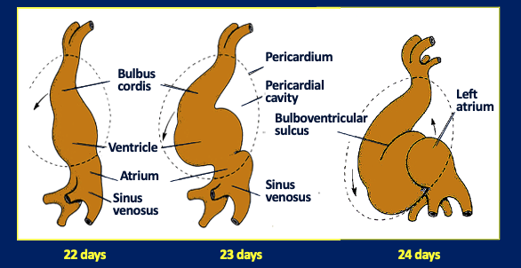
Looping of the heart
Why does it happen?
It forms loops to ensure that the heart stays in the pericardial cavity since ventricles and bulbus cordis grows faster. This is because the space doesn't increase in size
Notes:
The atria folds goes right behind the bulbus cordis
Heart is in the pericardial cavity- which forms pericardium

Slide 25
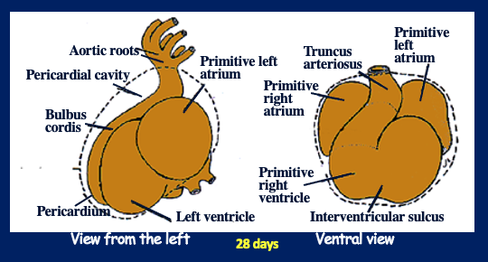
At 28 Days
Notes:
This is how it looks once folding is completed
Atria lie posteriorly and ventricle lies anteriorly

Slide 26
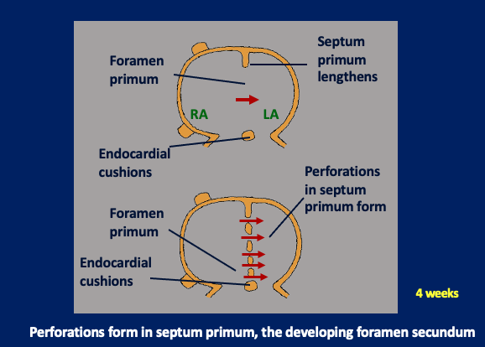
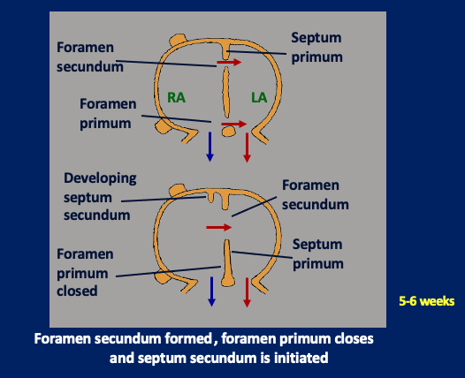
Septation of the Primordial Atrium
Notes:
The common atria is dived into the right and left atria
Cells that are Swelling are formed in AV canal which is known as endocardial cushion
They are on either side fuse together and form the septum intermediate
This divide into left and right
Roof of atria, the septum primum is there and lengthens towards the septum intermediate but doesn’t reach it and leaves a gap
Known as foramen primum or the oseto primum (Check that sney)
Perforations form and it reaches the septum intermediate
But there is a gap at the top and it is called foramen secundum

Slide 27
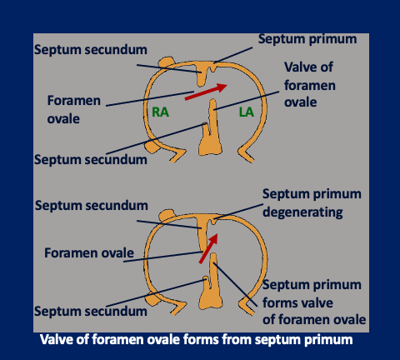
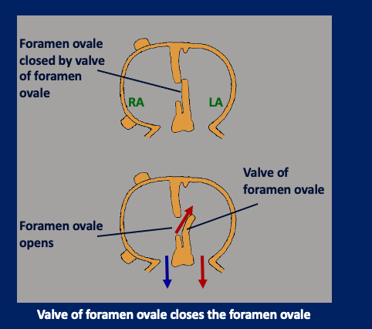
Notes:
On the roof of the atria there is another septum forming called septum secundum- starts to elongate downwards
New opening called the foramen ovale allows connections between right and left atria
Just after birth this closes up

Slide 28
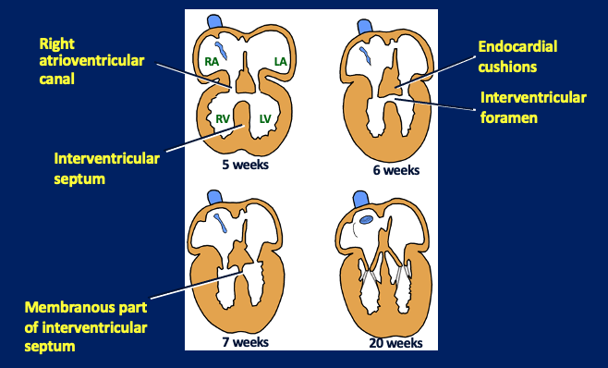
Septation of the Primitive Ventricle

Slide 29
Other things you need to look at
Cavitation of ventricles, formation of valves and great vessels
How the heart becomes 4 chambers

Slide 30
Thank You
References:
Langman’s embryology textbook
Slides from moodle
Email: mzyss46@nottingham.ac.uk

