Slide 1
Nasal cavity, air sinuses and respiratory tract
Arfaa Butt
mzyab26@nottingham.ac.uk

Slide 2
Learning Objectives
Consider the surface anatomy of the nose and neck (larynx)
Identify on the prosections; the hard and soft palates; structures forming the entrance to the oropharynx; the openings of the paranasal air sinuses and nasolacrimal duct
Identify on X-rays, CT scans and sections of the head; the nasal septum, conchae, meati, and paranasal air sinuses
Identify on the cadaver the lobes of the lungs and appreciate the division of the trachea into main, lobar and segmental bronchi so as to appreciate the presence and significance of bronchopulmonary segments

Slide 3
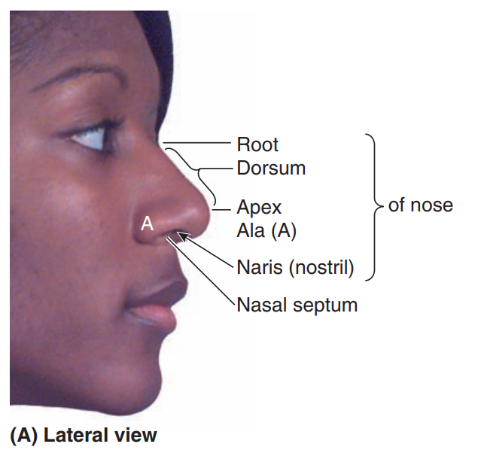
Surface anatomy of the nose
Key features:
Root
Bridge
Dorsum
Apex
Ala
Naris
Nasal septum
Notes:
Root= where the nose starts
Bridge= part between the eyes
Dorsum= connects the bridge to the apex
Apex= tip of the nose
Ala= Part around the nostrils (Ala= “wings”)
Septum= separates the two nasal cavities

Slide 4
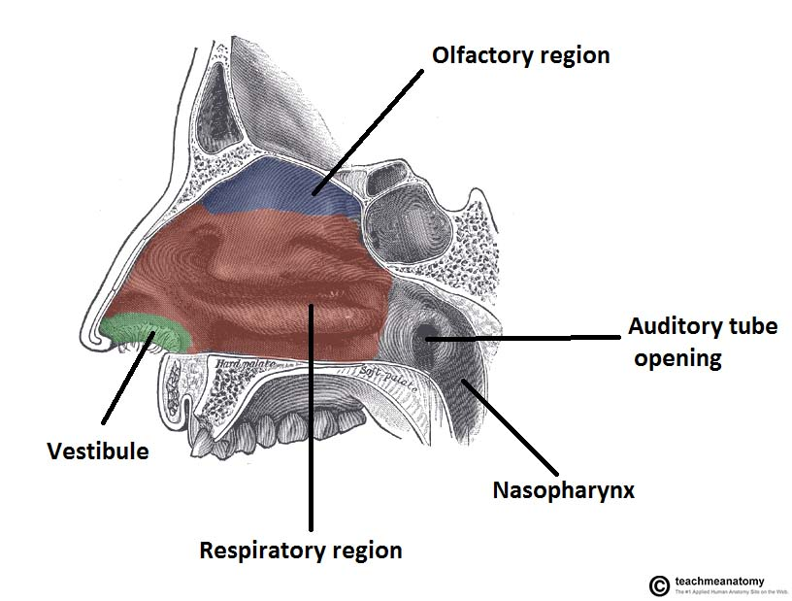
Structure of nose
Most superior part of the respiratory tract
Vestibule: Just inside nasal opening
Respiratory region: Lined with ciliated pseudostratified epithelium + goblet cells (mucous secreting)
Olfactory region: Lined by olfactory receptors
Notes:
Nose is divided into R and L by the nasal septum
3 main divisions on each side
Can see that most of the nose is made up of the respiratory region (inferior 2/3) and the rest (superior 1/3) is olfactory
Olfactory receptors sense different smells

Slide 5
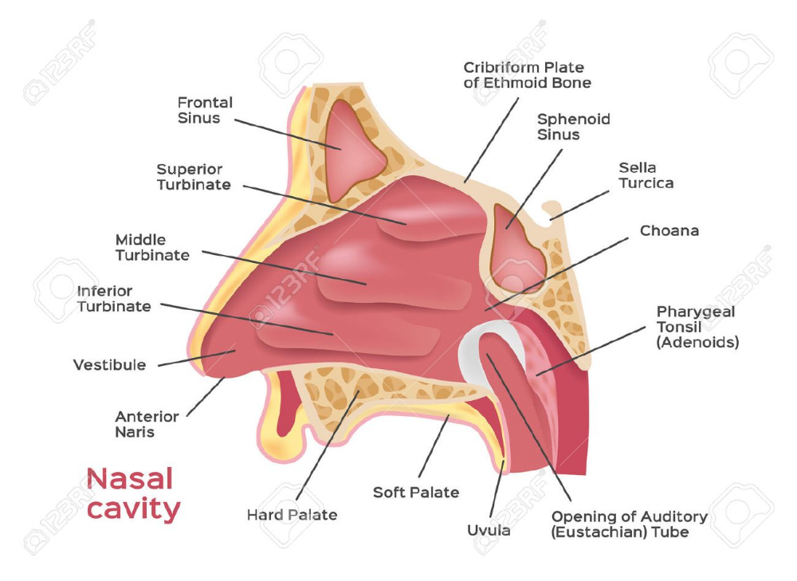
Functions of the nasal cavities
Conditioning the air
Respiration
Olfaction (smell)
Draining paranasal sinuses/lacrimal ducts
Notes:
Conditions air by warming and humidifying the air. Also removed pathogens by trapping them in mucous

Slide 6
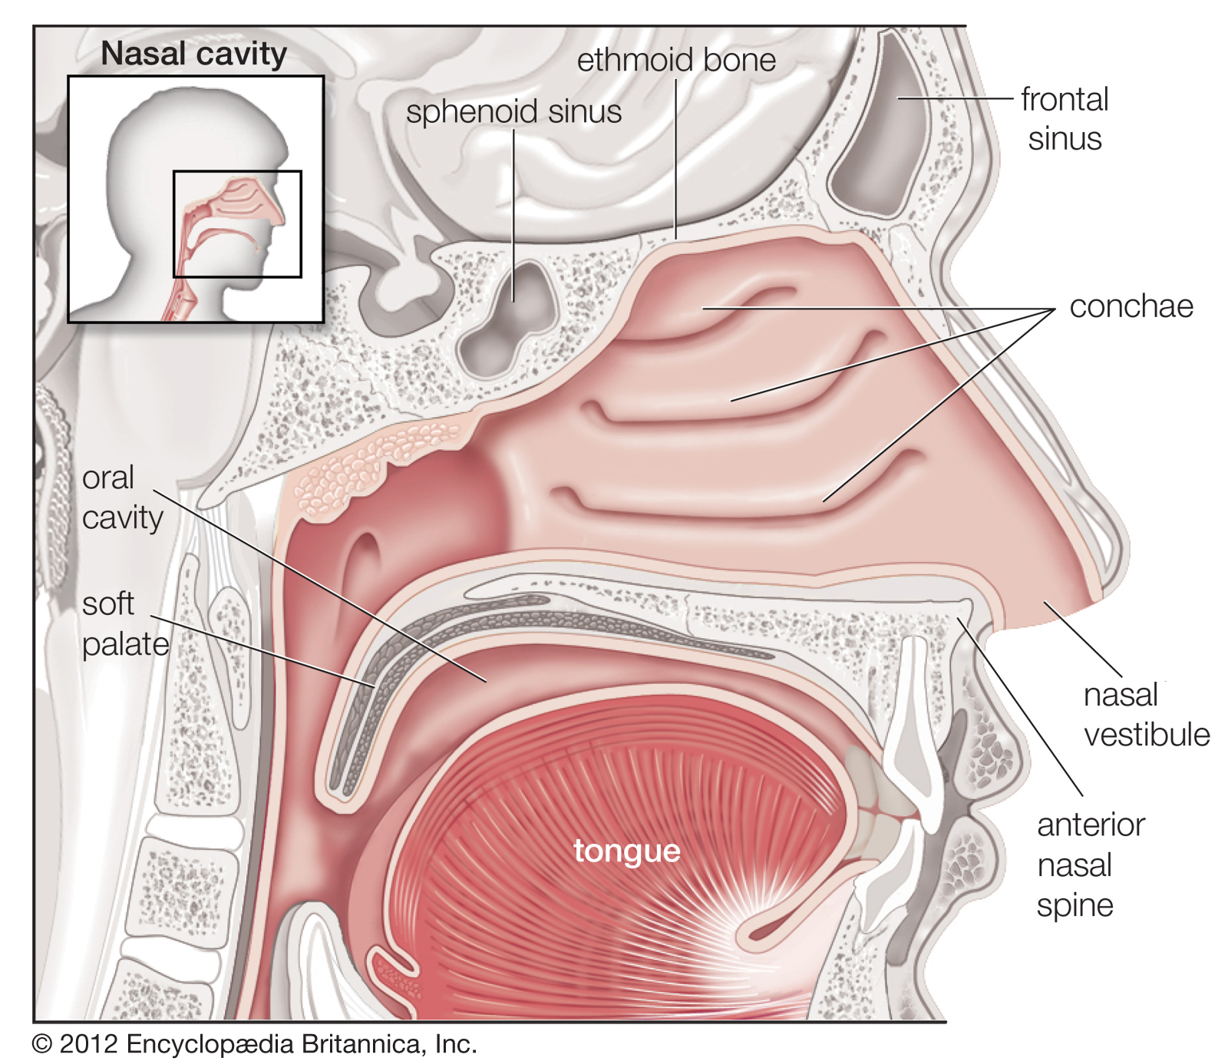
Boundaries of the nasal cavities
Superior: Ethmoid bone
Inferior: Hard palate
Medial wall: Nasal septum
Lateral wall: Conchae +Meati

Slide 7
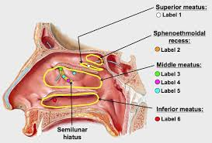
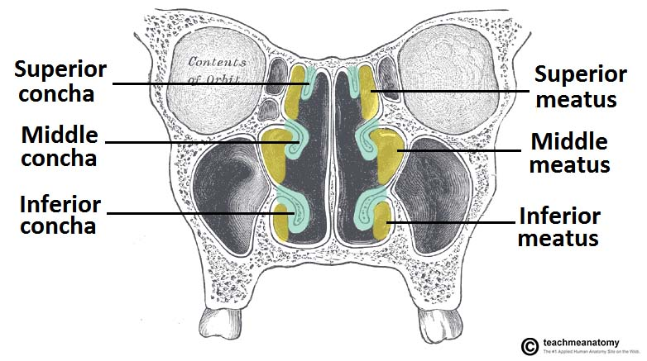
Structure of the cavities
Conchae/ Turbinate bones
  Superior
  Middle
  Inferior
Meatus
  Superior
  Middle
  Inferior
Spheno-ethmoidal recess: Space above superior conchae
Notes:
In the nasal cavity you have curved bones which project into the space = turbinate bones/conchae
Function:
Increase SA for conditioning the air
Disrupting the laminar (straight) air flow and making the flow turbulent, slowing it down → Better for humidifying the air
Meatus: Space created underneath the corresponding conchae

Slide 8
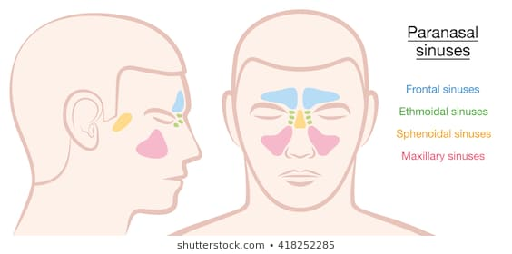
Air sinuses
Skull has sinuses (air spaces) within it, lined with respiratory epithelium
  Frontal
  Ethmoidal
  Sphenoidal
  Maxillary (largest)
Function:
  Increased SA for air conditioning
  Reduce weight of skull
Notes:
Remember that the sinuses are named after the bone they are located in

Slide 9
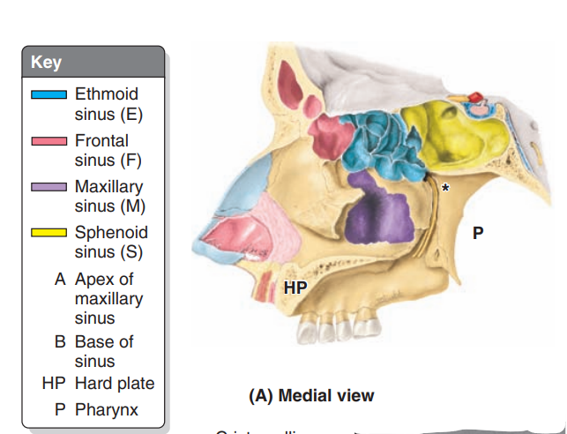
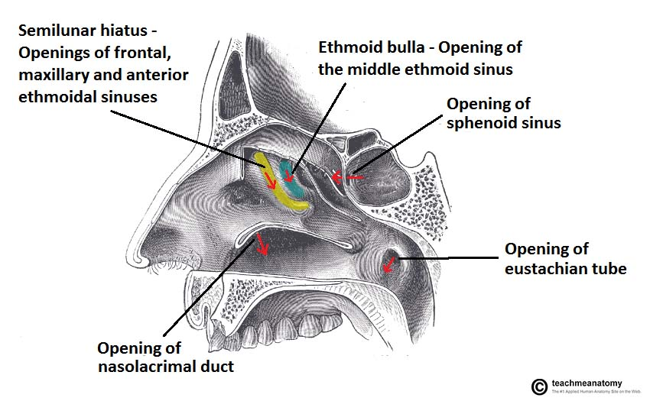
Drainage of the nasal cavity
Inferior meatus
  Nasolacrimal duct
Middle meatus
  Anterior and middle ethmoidal sinuses
  Frontal sinus
  Maxillary sinus
Superior meatus
  Posterior ethmoidal sinus
Spheno-ethmoidal recess
  Sphenoid sinus
Notes:
Each meatus receives drainage from a specific area

Slide 10
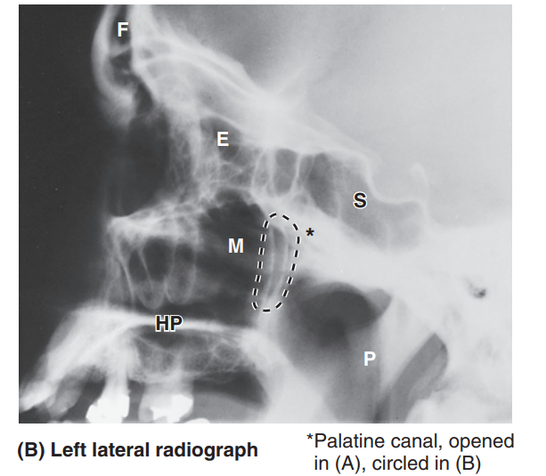
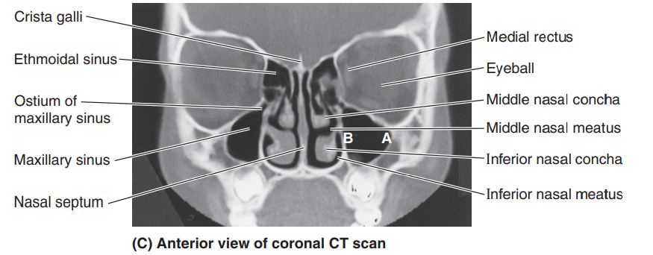
Imaging
Lateral
Frontal
Notes:
The sinuses will appear darker because they are filled with air
Be familiar with where they are located so that you can find them on x-rays

Slide 11
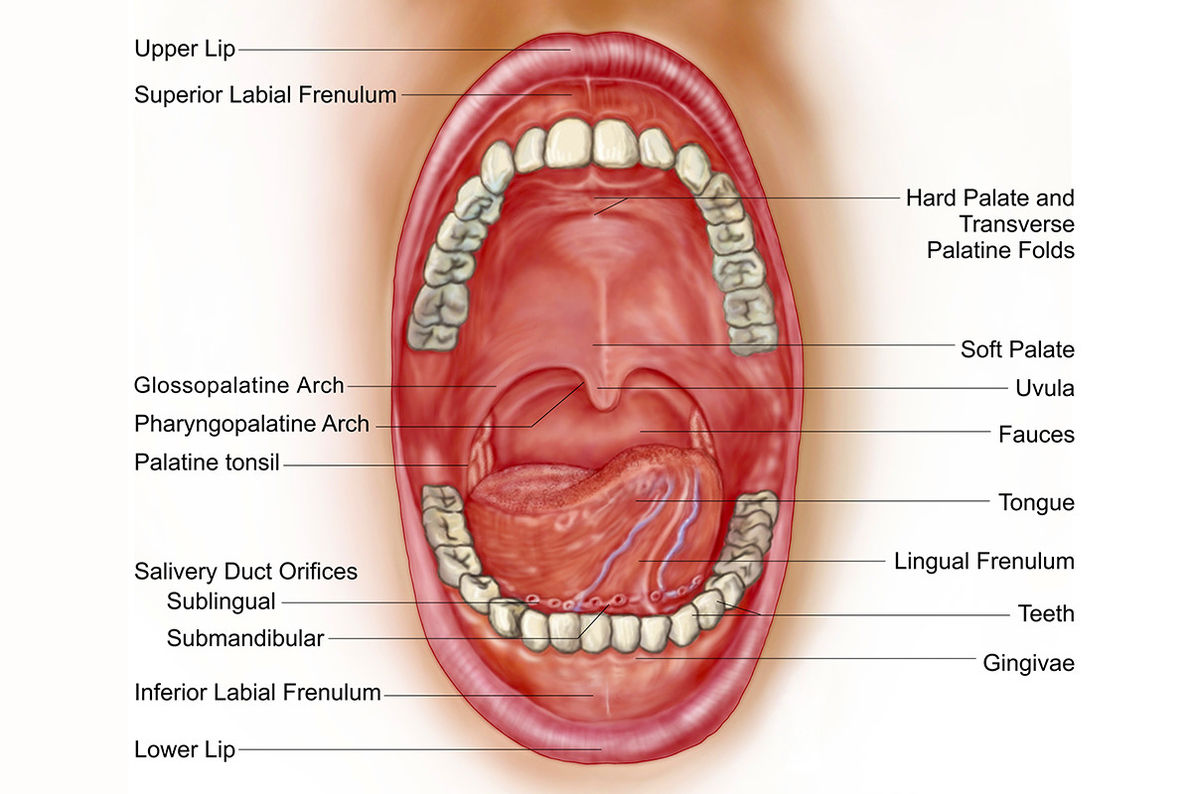
Entrance to the oropharynx
Palate
  Hard palate: Bony
  Soft palate: Muscular
Root of tongue
Pharyngeal arches
  Palatoglossal arch
  Palatopharyngeal arch
Tip: G comes before P in the alphabet
Notes:
Tip: G comes before P in the alphabet
Therefore palatoglossal before palatopharyngeal

Slide 12
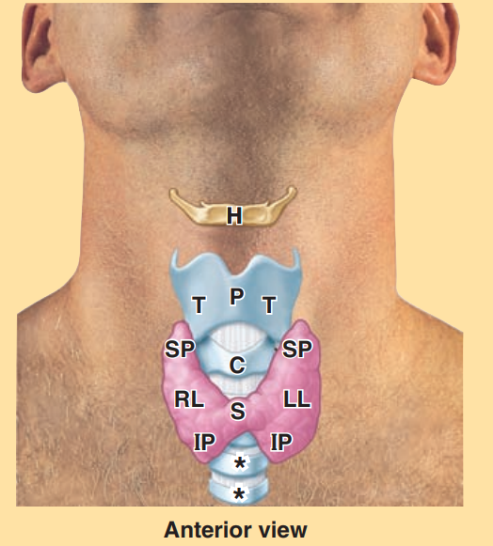
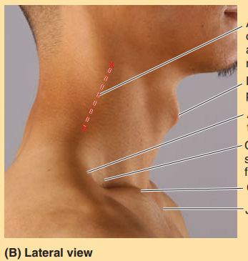
Surface anatomy of the neck (larynx)
Hyoid bone – C3
Thyroid Cartilage – C4-C5
Cricoid cartilage- C6
Tracheal rings
Laryngeal prominence
Notes:
H= hyoid
P= Laryngeal prominence
T= Thyroid cartilage
C= Cricoid cartilage
* = Tracheal rings

Slide 13
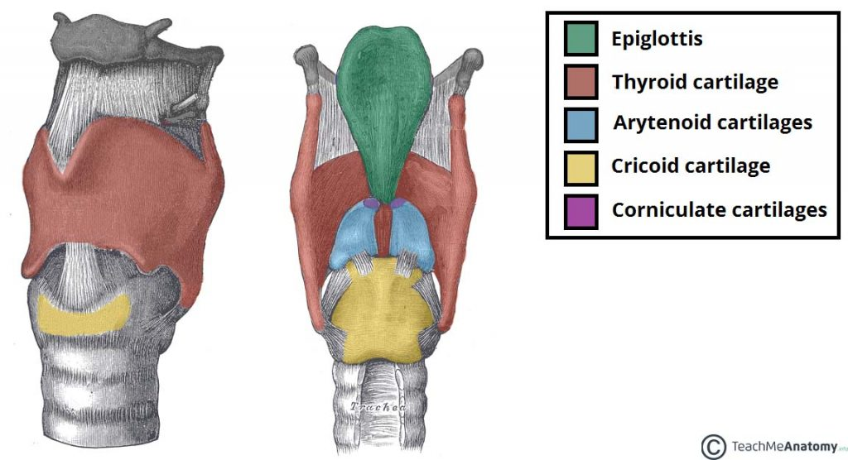
Structure of the larynx
Function
  Phonation (speaking)
  Cough reflex
  Protection of lower respiratory tract
Unpaired cartilages
  Thyroid Cricoid
  Epiglottis
Paired Cartilage
  Cuneiform
  Corniculate
  Arytenoid

Slide 14
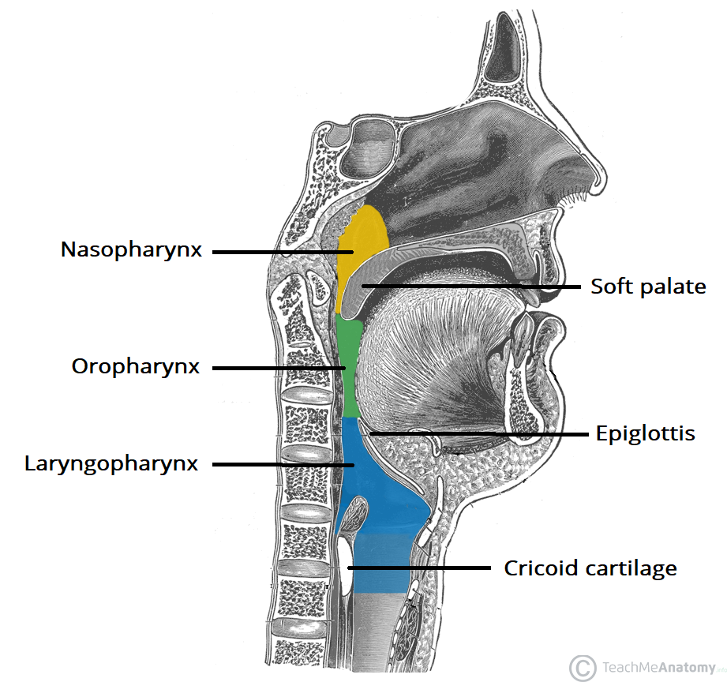
Pharynx
Role: Connect nasal/oral cavities to larynx and oesophagus
Nasopharynx = behind nasal cavity
Oropharynx= behind oral cavity
Laryngopharynx= behind larynx

Slide 15
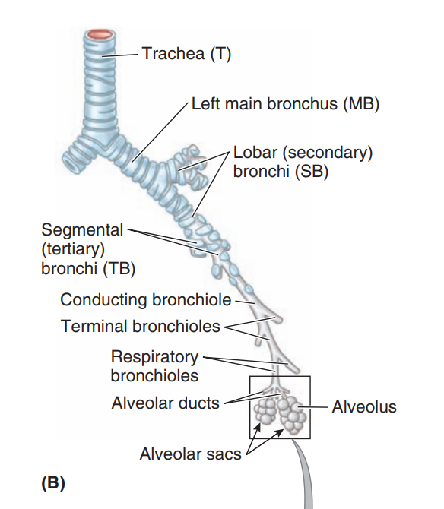
Respiratory tract
Trachea
R and L main bronchi
Lobar (secondary bronchi)
Segmental (tertiary) bronchi
Terminal bronchioles
Alveolar ducts
Alveolar sacs
Notes:
Remember: Bronchioles don’t have any cartilage in their walls but bronchi do

Slide 16
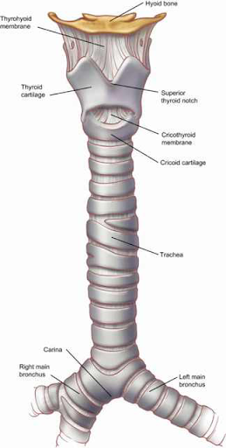
Trachea
Runs from C6 → T5/T4
At T4/T5 it bifurcates into R and L bronchi
Carina= ridge where the trachea bifurcates
R main bronchus is wider and more vertical
Clinical relevance= More likely for foreign objects to end up in R main bronchus
Notes:
Remember T4/T5 is an important landmark. It is also the level of the sternal angle

Slide 17
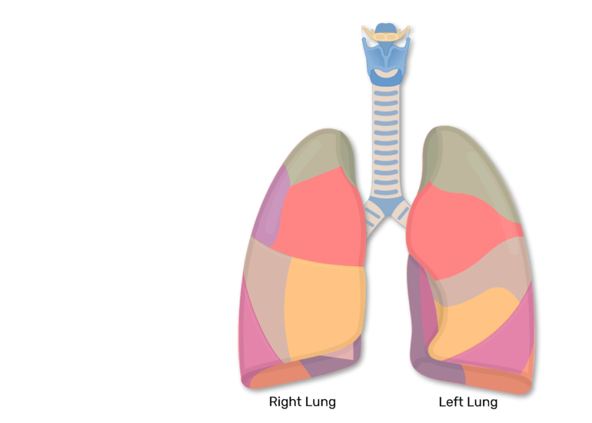
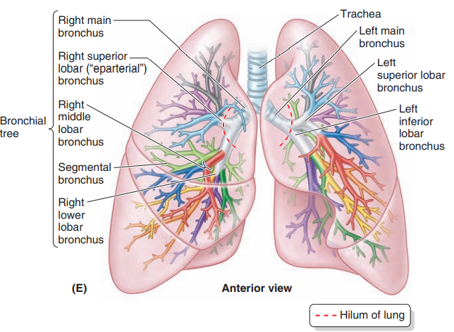
Bronchopulmonary segments
Each lobar (secondary) bronchi supplies one lobe
Each segmental bronchi supplies one bronchopulmonary segment
Bronchopulmonary segment= function unit of the lung
Clinical significance:
If there is damage or disease in one segment, it usually stays within that segment (if it hasn’t spread)
Surgeons only need to remove one segment rather thana whole lobe or lung = segmentectomy
Notes:
Remember there are 3 lobes in the R lung, 2 lobes in the L lung
Each colour represents a different segment or segmental bronchi

Slide 18
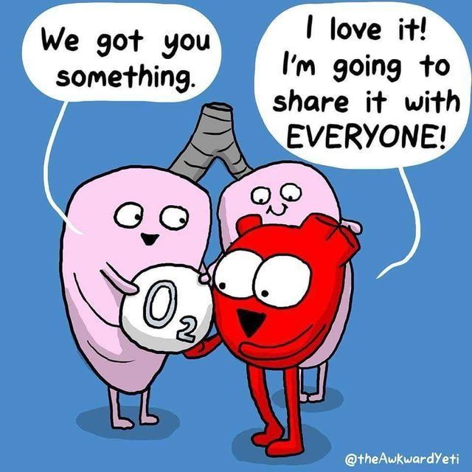


References
Essential Clinical Anatomy (Moor and Agur)
Teach Me Anatomy
Google Images
Questions?
mzyab26@nottingham.ac.uk
@SCRUBSNotts
scrubsnottingham
Nottingham SCRUBS Student Surgical Society

