Slide 1



EMBRYOLOGY
EMBRYOLOGY
PART 1: LIMBS
PART 2: CLINICAL CONDITIONS
PART 1: LIMBS
PART 2: CLINICAL CONDITIONS
Emayanthi Emayakumaran
mzyee5@nottingham.ac.uk

Slide 2
PART 1- EMI
LIMB BUDS, LIMB GROWTH AND PATTERNING, DIGIT DEVELOPMENT AND LIMB ROTATION

Slide 3
Recap
MESODERM
PARAXIAL
LATERAL PLATE
INTERMEDIATE
SOMITES
Splanchnic
Somatic
NEPHROTOME
(urogenital)
DERMAMYOTOMES
SCLEROTOME
DERMATOMES
MYOTOMES
mzyee5@nottingham.ac.uk
Notes:
Go through and question people on this.
Limb elements arise from paraxial and lateral plate of mesoderm.
Paraxial mesoderm (i.e. somites):
Dermatome - connective tissue of the dermis → forms the skin.
Myotome - limb muscles
Every dermatome and myotome arise from a single spinal segment.
Somatic layer of lateral plate mesoderm forms:
Bones of arm, forearm, hand, thigh, leg and foot
Blood vessels
Connective tissue (except for that of the dermis)

Slide 4
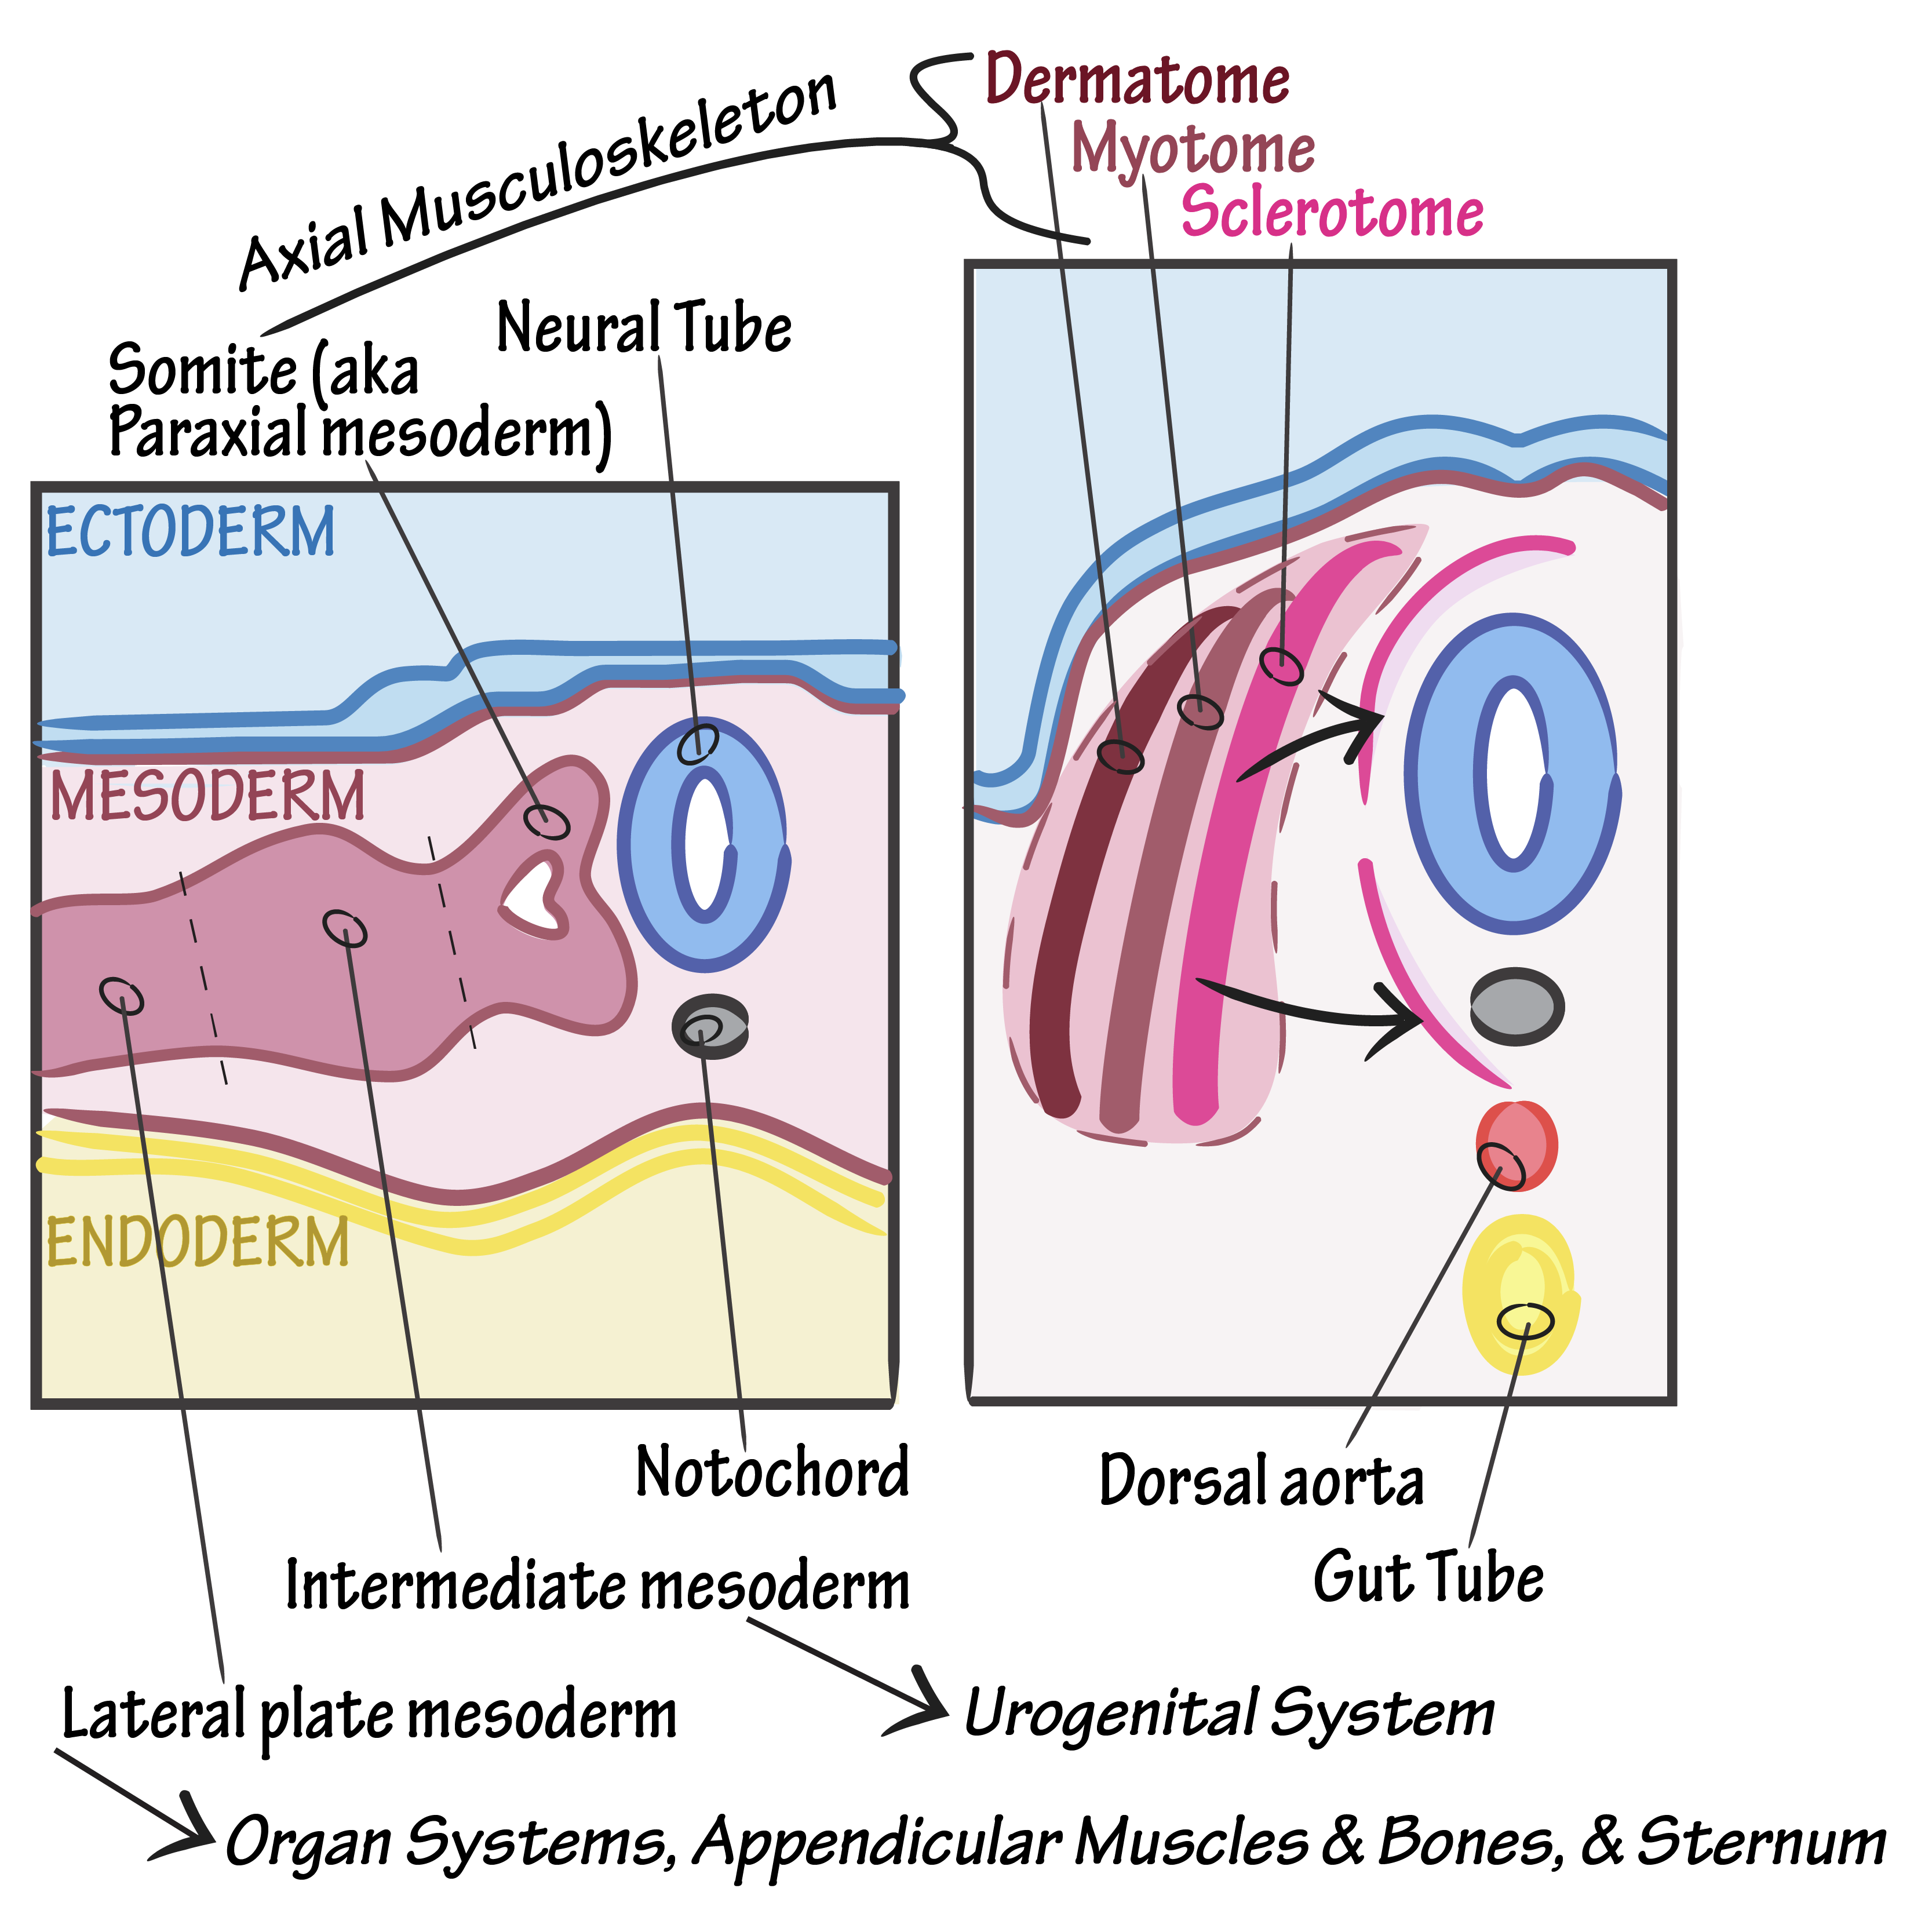
mzyee5@nottingham.ac.uk
Notes:
Image:
http://d1j63owfs0b5j3.cloudfront.net/term/images/2161-1597087491617.png
Peripheral nerve elements - derived from neural crest
The definitive notochord is a signalling centre for inducing the axial skeleton.

Slide 5
Limb buds
4-5th WEEK
mzyee5@nottingham.ac.uk
Notes:
Remember hind limb development lags behind forelimb development by 1 to 2 days. All happens between week 4 and 8.
Outpocketings form ridges on the lateral body wall
C5—T1 where brachial plexus is as it arises from here therefore supply the upper limb buds. Similar with lower limb buds – L2 to S3
Specific spinal segments determined by HOX genes
Ectoderm layer = (simple epithelium)
Apical ectodermal ridge (AER) = (thickening of ectoderm at distal border of limb)
Exerts inductive influence on adjacent mesenchyme.
Mesenchyme remains undifferentiated, rapidly proliferating.
Undifferentiated zone/zone of proliferation/progress zone.
Proximo-distal patterning of the limb.
AER at the distal part of the limb bud.
AER important that limbs outgrow and elongate. AER won’t allow the mesenchymal cells next to it (showing in red arrow) differentiate, hence it has the ability to elongate and outgrow.
Cells that are away from the AER, they can differentiate.
ZPA (zone of polarising activity) posterior aspect of the limb bud
Zone of polarising activity = (area of mesenchyme)
Situated in the posterior limb bud mesenchyme.
Antero-posterior patterning of the limb.
Mesenchymal core = (derived from the parietal (somatic) layer of lateral plate mesoderm – forms bones and CT)
Mesenchymal cells
Farther from the influence of AER begin to differentiate into cartilage and muscle
Differentiating zone.

Slide 6
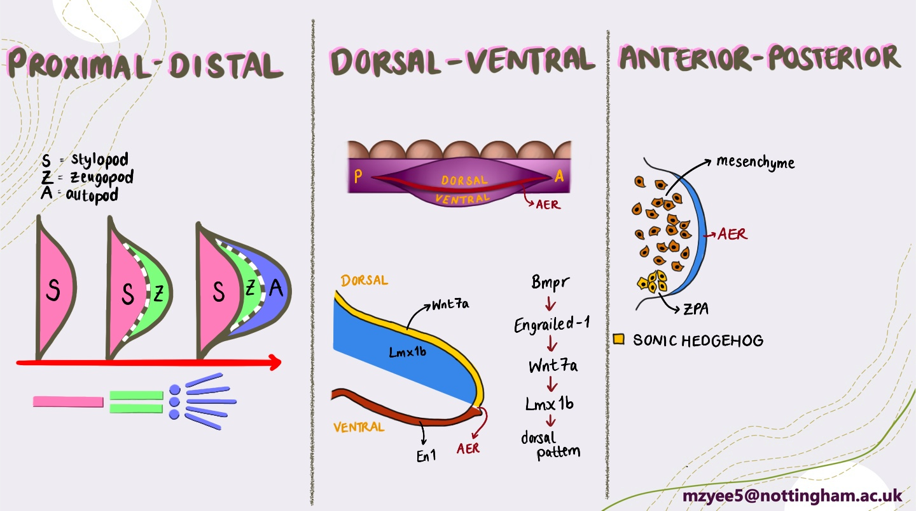

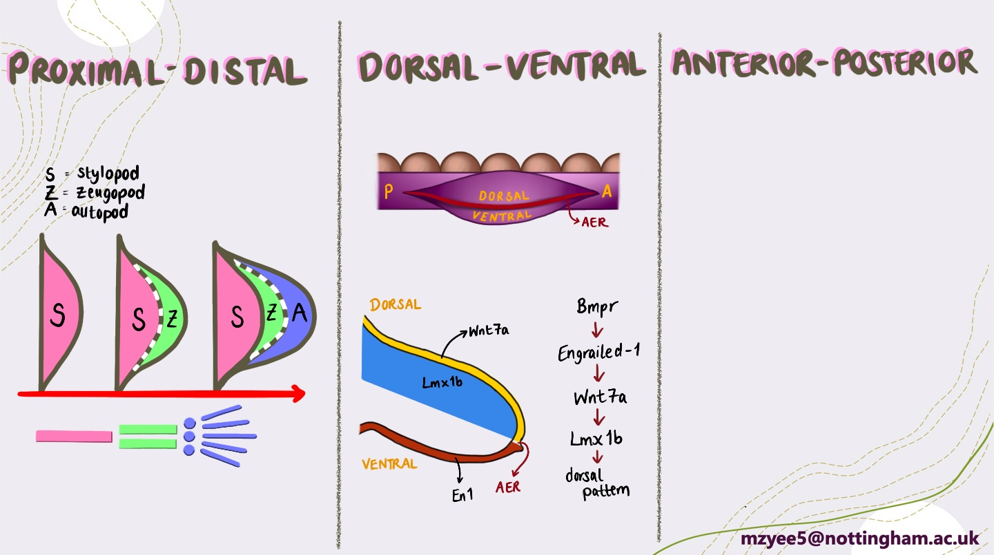
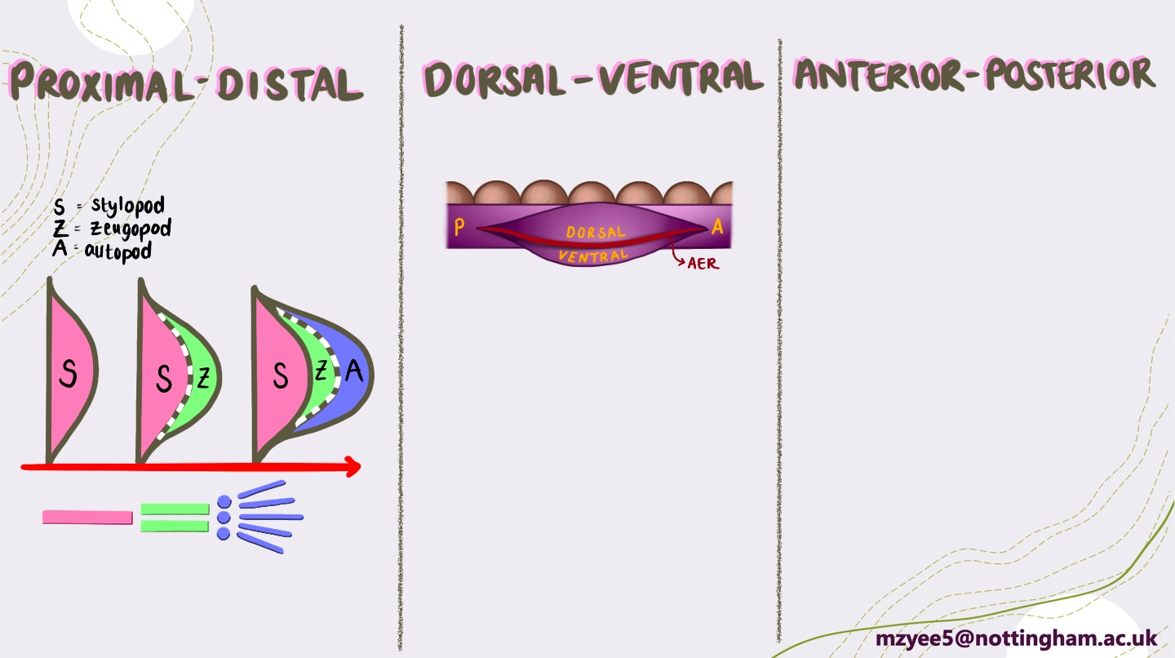
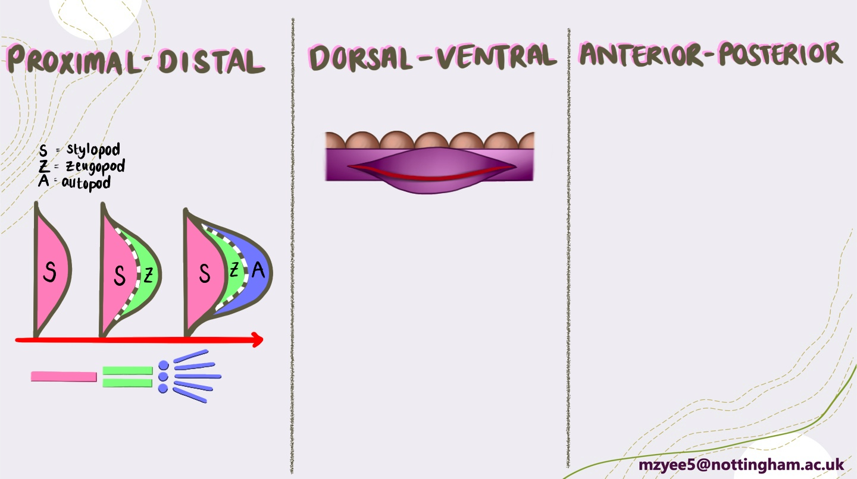
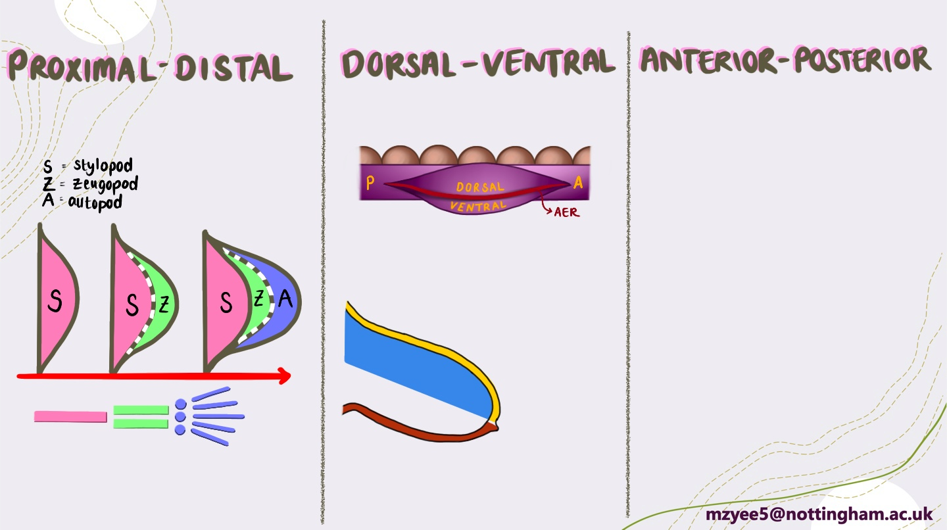



Limb Growth and Patterning
ZPA → SSH
AER – FGF4 and FGF8
Mesenchymal cells - RA
mzyee5@nottingham.ac.uk
Notes:
Patterning, growth, and maturation of the limbs occurs along three axes –
Proximal-distal axis
Dorsal-ventral axis
Anterior (rostral)-posterior (caudal) axis – embryological sense!
Because of all of the complexity, limb defects are among the most common of all birth defects with an overall incidence of 1:200 of all live births.
Thumb and radius lies on the anterior position whereas little finger and ulna lie on the posterior aspect.
Proximal-distal patterning
Limb outgrowth initiated by AER.
Proximal (i.e. shoulder or hip) to distal (i.e. hand or foot).
Proximal elements (humerus/femur) are formed prior to distal elements (ulna/tibia).
Area in purple is where the mesenchymal cells can’t differentiate, and area in green is where it can. So in the purple part
AER releases fibroblast growth factors (FGF4 and FGF8)
FGF4 and FGF8 maintains undifferentiated zone (rapidly proliferating population)
This induces distal growth. As proliferation causing elongation
(the green part) Due to distal growth -
Cells proximal to the undifferentiated zone are no longer under the influence of FGFs.
Begin to differentiate.
Retinoic Acid – produced by mesenchyme cells.
Anything that disrupts FGF signalling and/or formation and maintenance of the AER will result in arrested limb development
Stylopod = humerus, femur
Zeugopod = ulna + radius; tibia + fibula
Autopod = wrist + fingers; ankle + toes
Marker genes, are the genes that control the differentiation of these specific areas of the limb bud.
Stylopod
RA induces genetic cascade
Differentiation of stylopod
Marker gene: MEIS1
Other marker genes
Zeugopod: HOXA11A,D
Autopod: HOXA13 (HOX12A,D) unclear both genes implicated
Disruption of HOX genes (via mutation or teratogens such as retinoic acid or ethanol) will therefore
Dorso-ventral patterning:
D-V axis is controlled by the ectoderm.
Important for patterning muscles
Ventral muscles – flexors
Dorsal muscles – extensors
D-V signalling
BMPs in ventral ectoderm >
Express EN1 (Engrailed-1 ) in ventral ectoderm >
Repress WNT7a expression (restricting it to dorsal ectoderm) >
Expresses LMX1 (specifies cells to dorsal side) = establishes dorso-ventral components
Signalling factors are antagonistic and this is what sets up the AER specifically at the tip of the limb bud, so disruption of D-V signals will not only affect D-V patterning, but can also affect proximo-distal growth as well.
Antero-posterior patterning:
Antero-posterior is in the embryological sense.
Thumb and radius – anterior.
Little finger and ulna – posterior.
A-P patterning is established by ZPA.
SHH signalling from ZPA specifically signals the formation of posterior elements.
Posterior elements (e.g. little finger/ulna) are formed prior to anterior elements (e.g. radius/thumb).
ZPA (SHH signalling)
Upregulation = additional posterior elements (polydactyly).
Downregulation = fusion of digits, reduction of number of digits (syndactyly)
Loss = loss of posterior elements
Duplication = duplication of posterior elements.
Disruption of A-P patterning = can also result in loss of anterior elements and dysregulation of limb growth

Slide 7
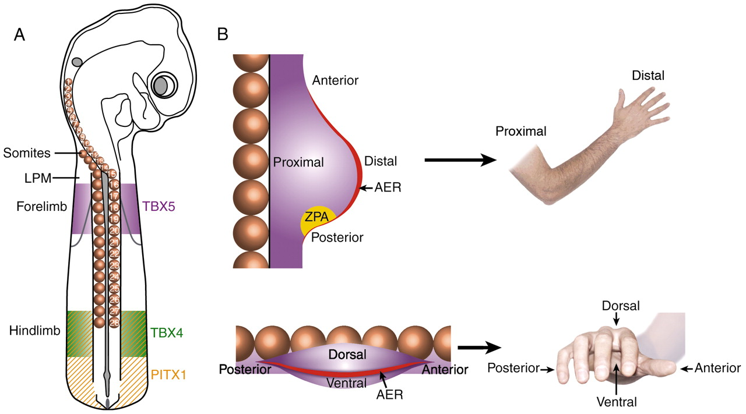
mzyee5@nottingham.ac.uk

Slide 8
Which of these following statements is correct.
Proximal-Distal patterning is controlled by AER which produces RA (retinoic acid).
Proximal-Distal patterning is controlled by AER which produces FGF.
Proximal-Distal patterning is controlled by the ectoderm
Proximal-Distal patterning is controlled by ZPA which produces SHH.
mzyee5@nottingham.ac.uk

Slide 9
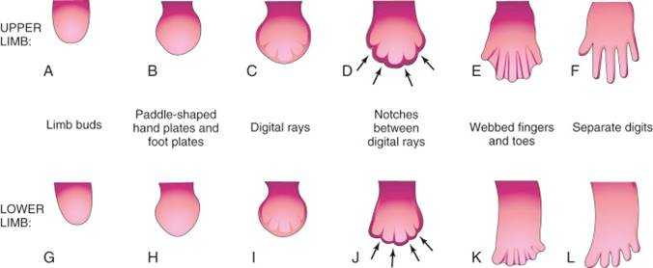
Digit Developments
mzyee5@nottingham.ac.uk
Notes:
6 weeks – circular constriction separates the hand and food plates from the proximal segment.
Later a second constriction to divide proximal portion (so arm and forearm or leg and thigh).
6th week – limb buds develop a constriction.
Constriction produces flattened distal segments to produce:
Upper bud – hand plate.
Lower bud – foot plate.
7th week - mesenchymal tissue in the plates condense to form digital rays.
Mesenchyme between rays disappear to form notches.
Digits are initially webbed together.
Interdigital apoptosis – programmed cell death to form the separate digits (by the end of 8th week).
Interdigital apoptosis first appears in the upper limb followed by the lower limbs.
Apoptosis of interdigital tissue is dependent on BMP signalling within the interdigital tissue under the influence of Shh from the ZPA. Disruption of this process can therefore result in syndactyly, and, not surprisingly, most often affects digits 3, 4, and/or 5.

Slide 10
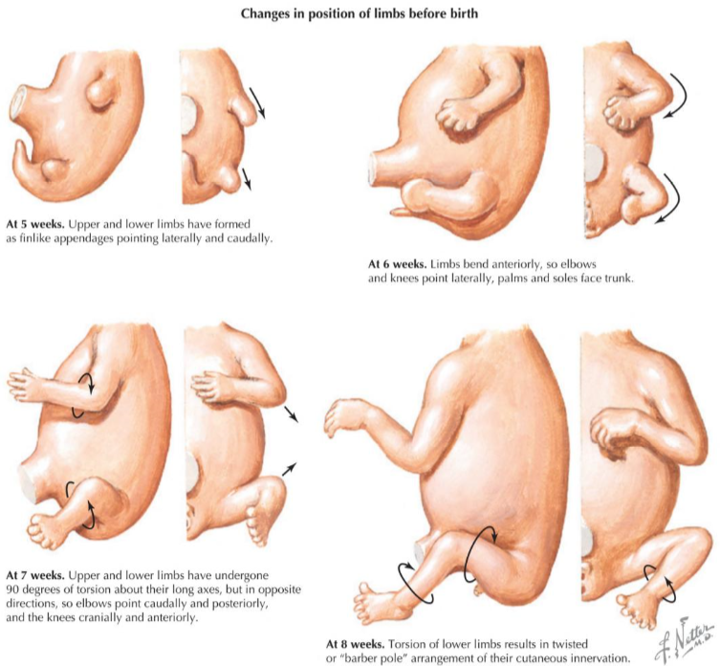
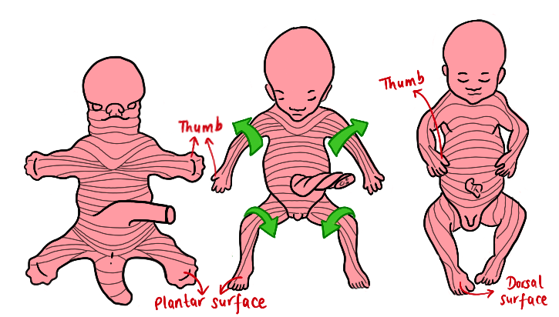
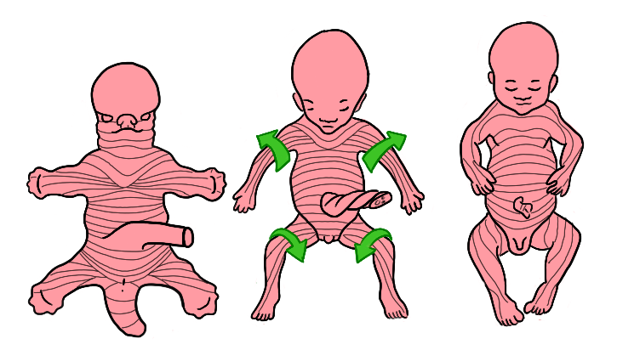
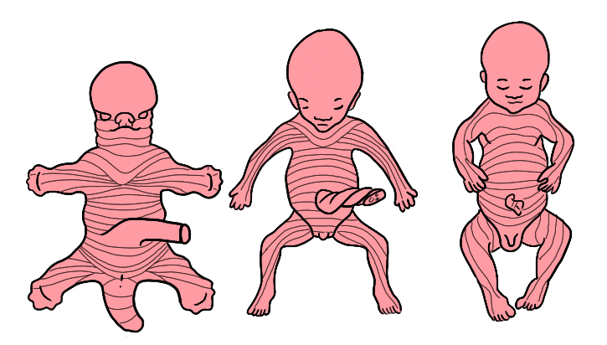
Limb Rotation
mzyee5@nottingham.ac.uk
Notes:
Limbs rotate in opposite directions
Upper limb
90° laterally
Anterior flexor muscle compartment – faces anteriorly
Posterior extensor muscle compartment – faces posteriorly
Elbow joint – point caudally and posteriorly
Thumb – laterally
Lower limb
90° medially
Knee joint – point cranially and anteriorly
Big toe – medially

Slide 11
Summary from the past 2 sessions
Week 2: Bilaminar Disc
  2 Layers
  2 Cavities (amniotic and yolk sac)
  2 Trophoblast derivatives (cyto- and synchtio-)
Week 3: Trilaminar Disc
  Ectoderm
  Mesoderm
  Endoderm
Week 4: Four Limbs
mzyee5@nottingham.ac.uk

Slide 12
Summary from today
P-D patterning is controlled by AER, which releases FGF (in the proliferating zone)
In P-D patterning, mesenchymal cells in the differentiating zone produces RA (retinoic acid).
D-V patterning is controlled by ectoderm.
A-P patterning is controlled by ZPA which has SHH signalling
Upper Limb rotation; lateral; elbow joint pointing up, thumb laterally. Lower limb opposite.
mzyee5@nottingham.ac.uk

Slide 13
Thank you!
Hope this session was useful!
If you have anymore questions or queries, don’t hesitate to contact me: mzyee5@nottingham.ac.uk
Resources Used:
LMS Lecture
Langman’s Medical Embryology

Slide 14
PART 2- SNEHA
LIMB MYTOMES, LIMB DERMATOMES AND CLINCAL CONDITIONS

Slide 15
Limb Bones
What bones are we looking at for upper limb?
What bones are we looking at for lower limb?
We are looking at the humerus, radius and ulna in the upper limb
We are looking at the femur, tibia and fibula in the lower limb

Slide 16
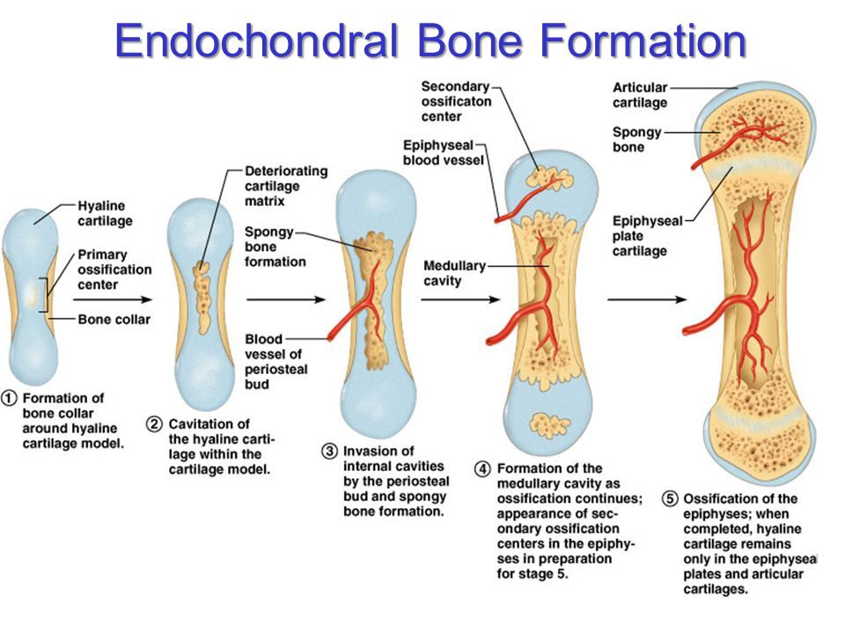
Firstly how is bone formed?

Slide 17
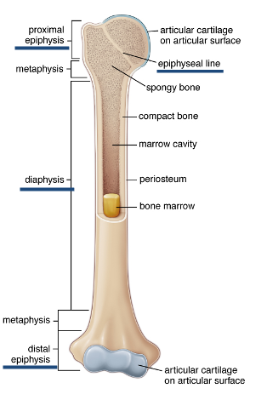
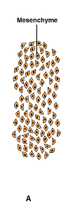

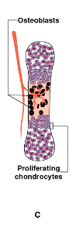
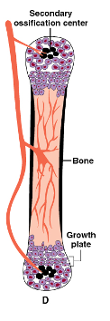
Endochondral Bone Formation
Notes:
Chondroblasts form cartilage which comes from chondrocytes
You have got the mesenchymal tissue which differentiates into the pods
Stylopods- humeurs and femur
Zeugopod- ulna and radius and tibia and fibula
Autopod- wrist and fingers and ankle and toes
So they condense to form chondrocytes which is a cartilage plate of the bone, which is like a blueprint of the bone, then blood vessels invade the blueprint and bring osteoblasts (which are black)
Then these osteoblasts then slowly begin to form the bone pushing the chondrocytes to the end of the bone, and then finally they begin to mature
Both osteoblasts and chondrocytes
What is the epiphyseal line- fused growth plate
All bones are formed this way

Slide 18
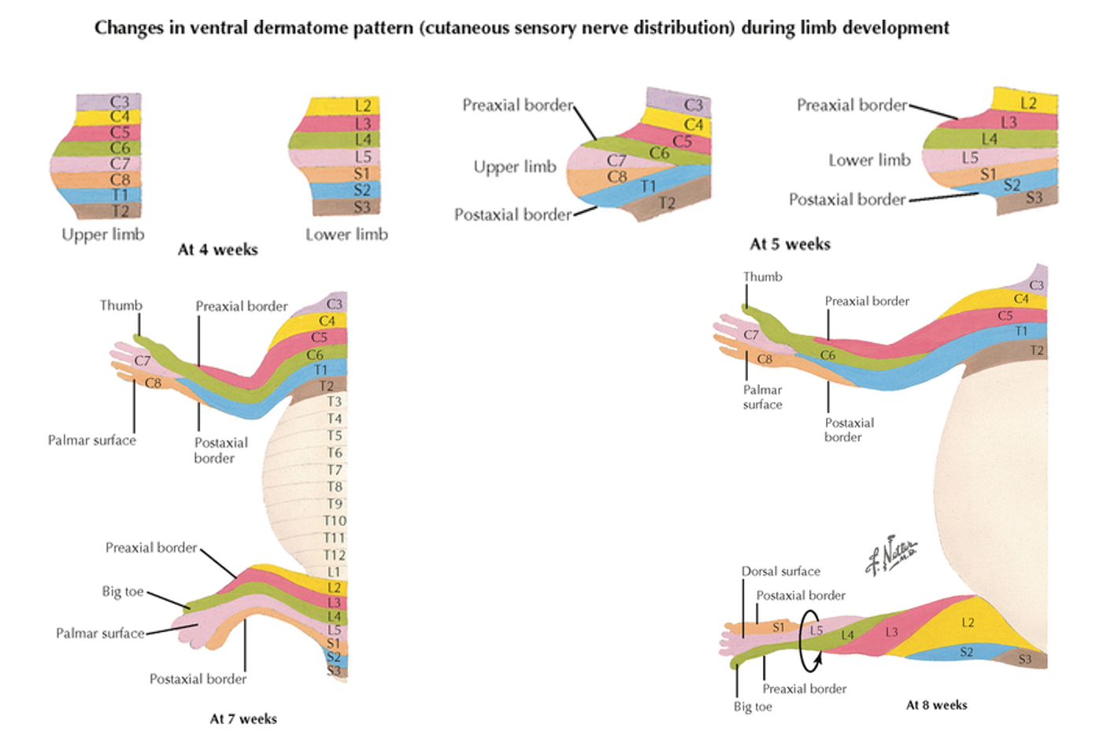
Dermatomes of Limbs
What does Dermatome mean?
Dermatome- A localized area of skin that is has its sensation via a single nerve from a single nerve root of the spinal cord
Notes:
They form the skin and they are supplied by a single spinal segment
The upper limb is uniform
Lower limb is twisted due to the rotation, so the dermatomes also rotate along with it

Slide 19
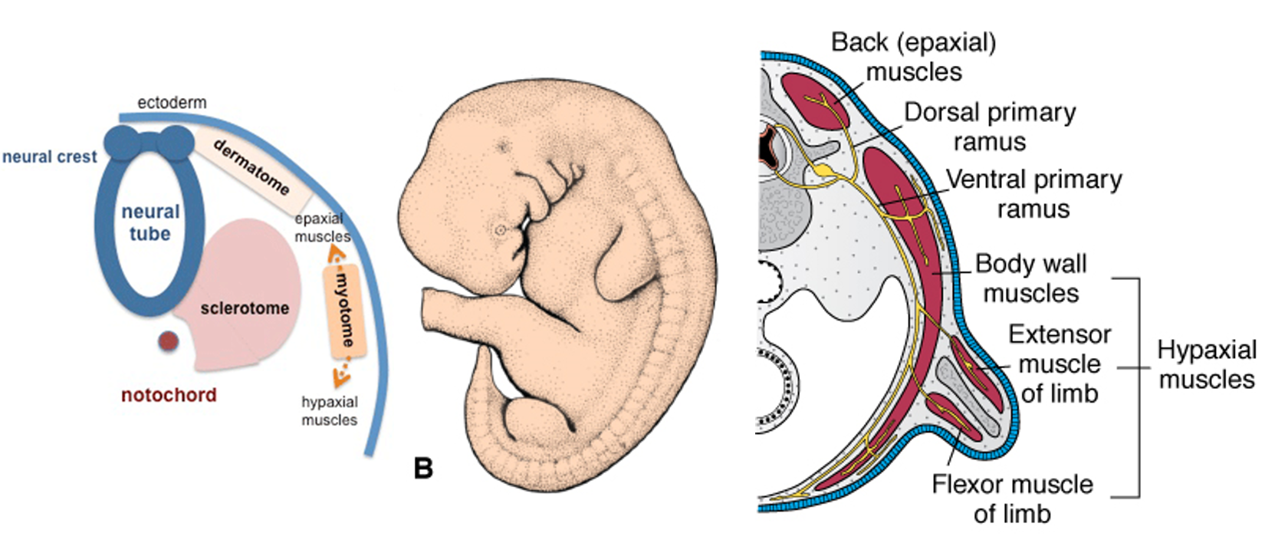
Myotomes
What does myotome mean?
Myotomes are a set of muscles innervated by a specific, single spinal nerve.
Notes:
Myotomes are in the paraxial mesoderm
As the limb bud elongates the myotomes move with it
Myotomes – myogenic precursor cells
Migrate in to limb buds
Differentiate into myoblasts
Myoblasts aggregate – large muscle mass
Muscle mass separates –
Dorsal (flexor) compartment
Ventral (extensor) compartment
This is due to the dorsal ventral patterning- flexor and extensor muscles
As they are moving the patterning makes sure they separate
Dorsal is flexor
Ventral is extensor
Genes in dorsal ectoderm and ventral ectoderm
Upper limb- c5-c8

Slide 20
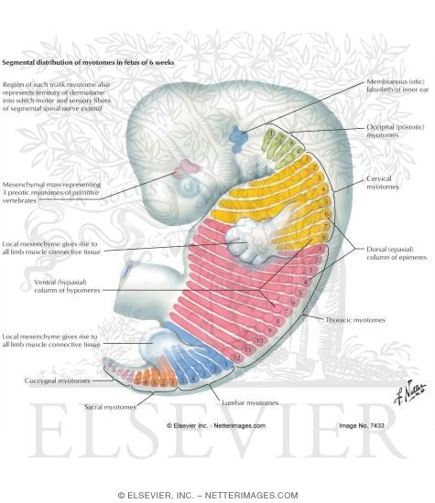
Myotomes Formed in Embryo at 4 weeks

Slide 21
Malformations of the Limbs
Achondroplastic dwarfism
Spondyloepiphyseal dysplasia congenita
Disruption of growth and/or patterning
Holt–Oram syndrome
Osteogenesis imperfecta

Slide 22
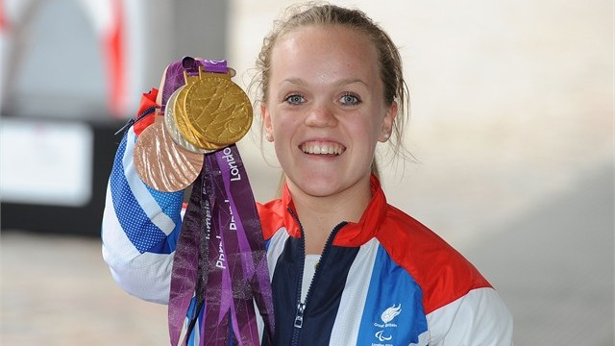
Achondroplastic dwarfism
Bone growth disorder - disproportionate dwarfism - short in stature with a normal sized torso and short limbs
Occurs when there are defects in chondrocyte proliferation
Premature closure of epiphyseal growth plates
Notes:
Ellie Symonds- won 4 paralympic gold medals

Slide 23
Disruption of growth and/or patterning
Amelia: absence of an entire limb (e.g. early loss of FGF signalling)
Meromelia: absence of part of a limb (e.g. later or partial loss of FGF signalling)
Phocomelia: short, poorly formed limb (e.g. partial loss of FGF; or Hox disruption)
Adactyly: absence of digits (e.g. even later loss of FGF)
Ectrodactyly: “Lobster-Claw” deformity (FGF variant of adactyly –middle digit is lost)
Polydactyly: extra digits (disruption –usually upregulation– of Shh pathway)
Syndactyly: fusion of digits (BMP or Shh disruption)
Notes:
Fibroblast growth factor signalling
Shh pathway mentioned during digit formation
BMP pathway also mentioned during digit formation

Slide 24

Thank you for Listening
Langman’s Medical Embryology
Lectures
Core anatomy

